Slide 1

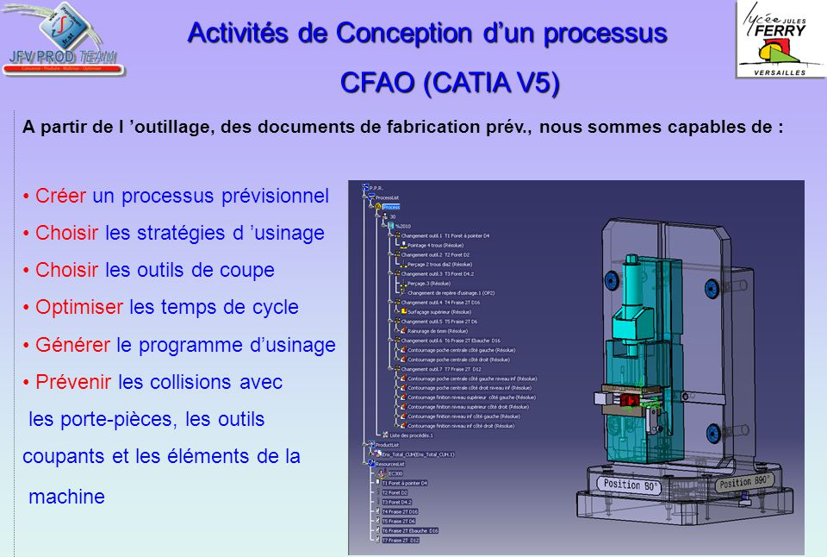
A day at the research department.
For the science party, on Thursday October 12th 2017, we went to CNRS (a french center of scientific research) at Grenoble. We are going to do a summary about our visit in the research department.
The job as an engineer in a research department:
The engineers of the research department develop prototypes in order to answer to the scientists needs. Their job is to apply research, study processes, analyse and test, where complicated calculations are made.
Their products are developed from the software of CFAO CATIA V5 of Dassault-systèmes company, where accurate conceptions and drawing softwares are important. Scientists write up an exact method which must be followed by the engineers.
The formation :
This job needs a formation of BAC +5 at engineering school or a master’s degree at a University. The level of the studies defers according to the company’s pre-requisites, and can request a doctorate. One can also join the research department after a BTS ATI and climb the ladder over time.
The salary:
For novice engineers in research department, the annual salary ranges from 30 000 to 40 000 €.
The senior engineers can earn up to 80 000 € per year.
At CNRS:
At CNRS, the engineers at the research department work for researchers. At the beginning, the researcher formulates his request to the research department which will value it, estimate his cost and his feasibility. For that, the engineers of CNRS use software in order to support their knowledge and therefore to determine the constraints of the part to realise. This constraints differ according to the utility you do with the object and material. The computerize plan accomplished by engineers permit a best comprehension of the project.

Slide 2
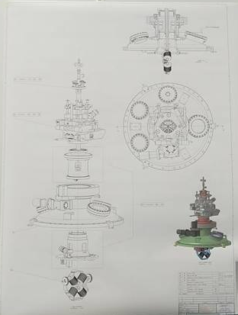
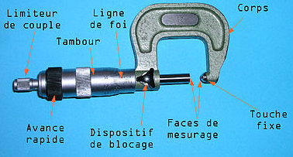
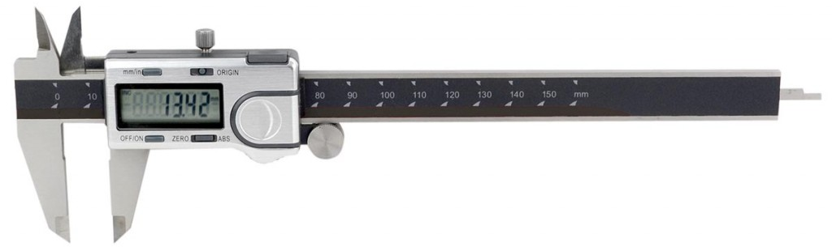
The engineers will design the machine part by part on the computers thanks to 3D software which make an accurate plan of each piece that compose the machine.
Also on the 3D software, sizing calculations can be made to test the machine and evaluate its resistance to the different constraints of the specifications to determine the adequate materials and the layout to minimize the risks of accidents.
Then, the exploded view is committed to manufacture where we find three principals kinds of manufacture :
-3D printers, can be used to make very small and complex pieces. It doesn’t lose material, but the raw material used by these machines is very expensive. Moreover their production is quite slow so the machines don’t operate with the mass production but rather with the manufacturing of prototypes;
-the engineers can also dig in a block of the wanted material to obtain the piece. This technique has the advantage that the raw material has a low price despite the large losses of material (the scraps) which can not be recycled ;
-the third made of manufacturing uses extremely expensive moulds (which can cost up to millions of euros) whereas low-priced molten materials take lots of time to be produced. It matches with the large-scale production unlike the 3D printers.
When all the pieces made by the machine are manufactured, they go to the assembly room where engineers check the precision of the dimensions of the pieces thanks to tools accurate to the 100e of millimeter like :
-the measuring instrument for bores (= l'alésomètre) allows to measure the diameter of cylindrical holes ;
-the slide caliper is used to measure little length with a great accuracy

Slide 3
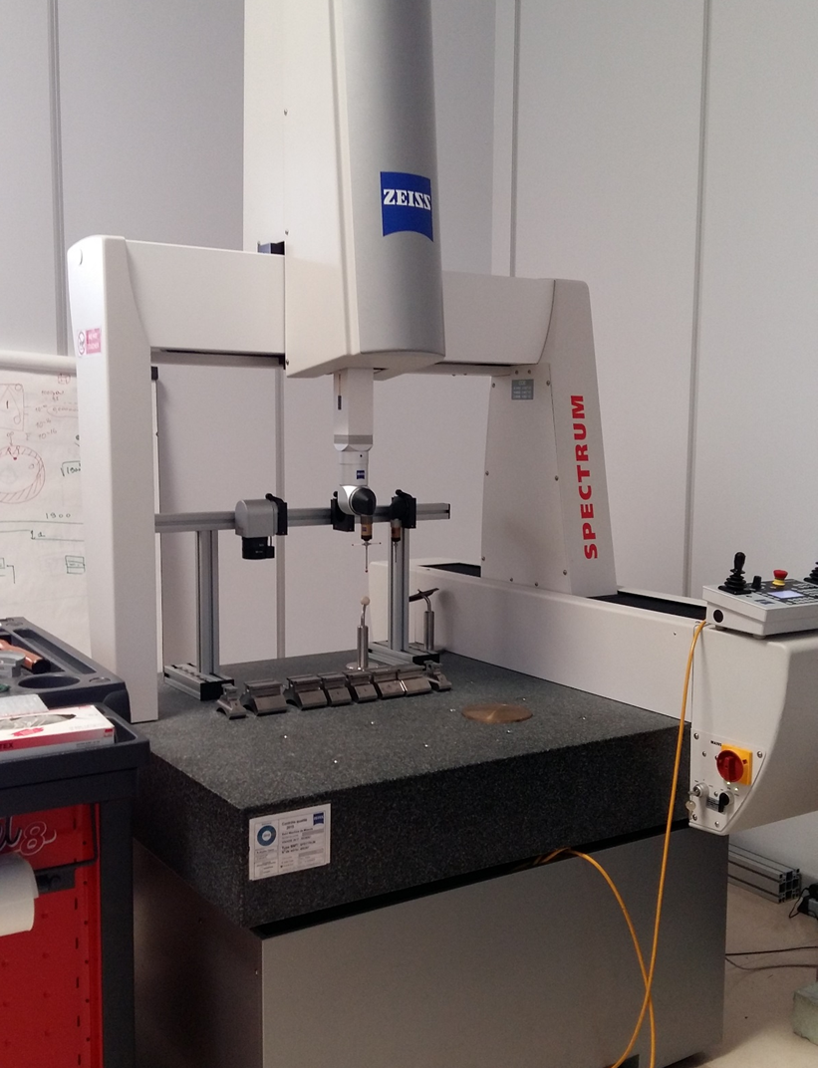
-the three-dimensionnal measurement machine which replenish a piece on a 3D software thanks to a stylus in synthetic ruby that examine the piece in many areas.
The room is air-conditioned at 20°C to prevent any distortion of the pieces usually due to termal changes.
The researcher will test the prototye in order to determine new constraints that were not discovered. The prototype could be send back to the research department which will take into account the new constraints.
However, the researchers rely on public financing from the region, state, Europe or private company, where projects could not take place without it.
We hope that you liked our article and you found it interesting like we did during our visit at the CNRS.
Inès BOURASS, Gaspard LAMBERT, Garance CHRZAN.

